Slide 1

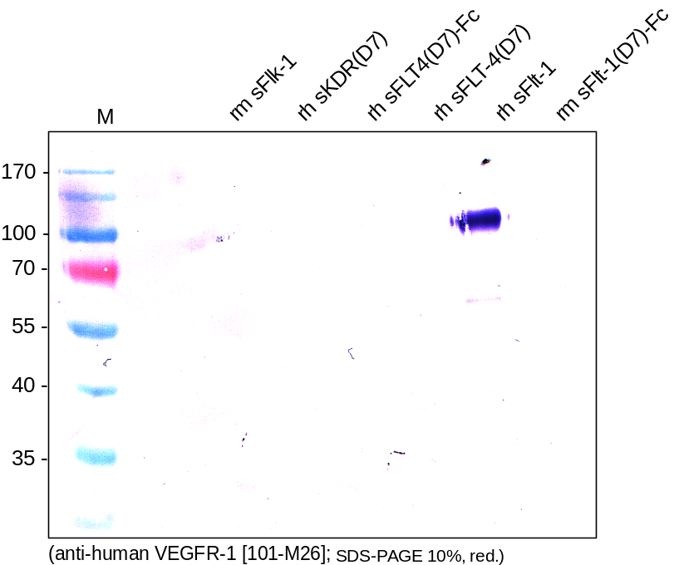
ReliaTech GmbH
Mouse anti-human VEGFR-1/Flt-1 (#EIC)
(Cat #101-M26)
Figure 1. Western analysis with different recombinant soluble VEGF receptor proteins using a monoclonal anti-human VEGFR-1/Flt-1 antibody [Cat# 101-M26]. The antibody shows no cross reactivity with mouse sFlt-1, mouse sFlk-1, human sKDR and human sFLT-4.
http://www.reliatech.de / orders@reliatech.de

